Slide 1



IQQS Company
HR Performance Management
Report Presentation
December 2024
Kareemasg65@gmail.com

Slide 2

Table of Content
01
05
Introduction
Key Objectives
02
06
Sections of Dashboard
Performance
03
Vision & Mission
04
Goals

Slide 3



introduction
our dataset revolves around HR metrics, focusing on employee attrition and related factors, such as demographics, job roles, satisfaction levels, and career progression. Attrition—employees leaving the organization—represents a key challenge for businesses, impacting productivity, morale, and costs associated with recruitment and training.

Slide 4
Dashboard Sections
Our dashboard pages contain information about employee health, turnover rates, performance satisfaction, departmental compensation and career path
Each page contains important details about employees, their workload and their performance.

Slide 5



Vision & Mission
Company Vision
Company Mission
build a resilient and employee-centered organization by addressing attrition challenges through actionable insights, fostering a workplace culture that promotes satisfaction, growth, and mutual success for both employees and the organization.
Utilize robust data analytics to identify key trends and patterns driving employee attrition, ensuring a deeper understanding of employee needs and challenges.
ridge gaps between departments like Sales and Human Resources to address role-specific challenges, ensuring that policies and practices reflect the unique needs of each team.
Ensure the insights and strategies derived from this analysis not only reduce attrition but also improve overall employee satisfaction, organizational productivity, and financial performance.

Slide 6
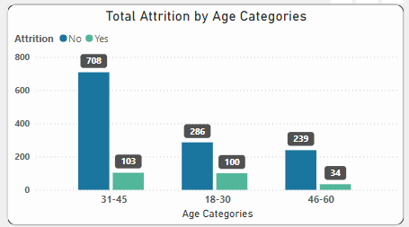
Total Attrition of Age Categories
Highlights:
Most of the employees who are attrited are between the ages of 31-45 and the second is from 18-30 which indicates that they have a heavy workload and most of them do not have any increase in income and work overtime more than once a month which makes their productivity badly and they do not continue
Challenges:
Age Sensitivity
Heavy Workload
Overtime System
Career Development Opportunities

Slide 7
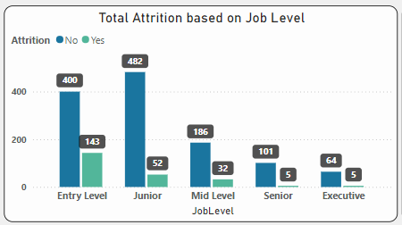
Total Attrition by Job level
Highlights:
Differentiating levels of jobs in departments based on job role is important, but without any knowledge of how to manage, lead, motivate or distribute work on a regular and scheduled basis, the company loses young people who could be very important to the future of the company.
Challenges:
Lack of Management
Poor Work Distribution
Failure to Schedule Regular Check-Ins
Inadequate Motivation Strategies

Slide 8
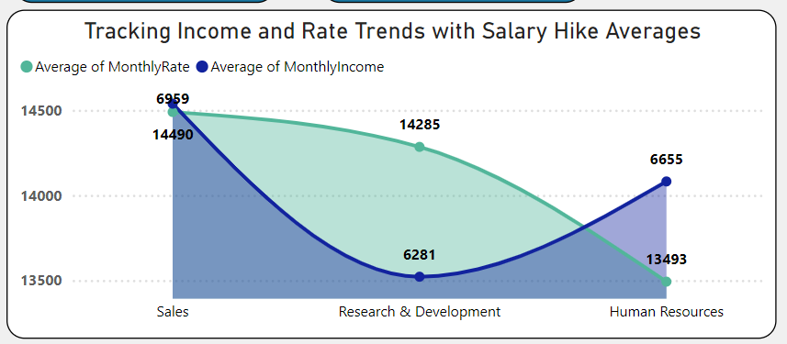
The Cost of Low Pay on Talent Retention
Highlights:
The visual depicts a direct correlation where lower monthly incomes, particularly in departments like R&D, coincide with higher attrition rates.
While the Sales department boasts the highest income, it may also experience attrition due to pressures and performance expectations, suggesting that high income does not always equate to low attrition.
Challenges:
The current compensation structure seems unbalanced, necessitating a reassessment to ensure that all departments are adequately supported to retain talent.

Slide 9



Key Stakeholder Messages
For Leadership: Highlight the financial benefits of reducing turnover and investing in employee growth.
For Managers: Empower them with insights to support their teams effectively and retain top talent.

Slide 10


Strategic Goals
Enhance Employee Retention
Improve Work-Life Balance
Foster Career Development
Interventions by Department
Mitigate the negative impacts of overtime and frequent travel through flexible scheduling and remote work policies.
Establish clear career progression pathways to ensure employees feel valued and motivated to grow within the organization.
Address specific challenges in high-attrition departments, like Sales, by reevaluating workloads, expectations, and rewards.
Reduce overall attrition by creating a supportive, growth-oriented workplace environment

Slide 11


Key
Objectives
Retention Initiatives
Set a goal to reduce attrition rates by 10-15% within the next 12 months.
Implement exit interviews and employee surveys to identify specific pain points.
Compensation and Benefits Optimization
Conduct a salary benchmarking study to ensure competitiveness in compensation, especially for employees in younger age groups or lower-income brackets.
Career Growth Opportunities
Create mentorship and upskilling programs, targeting employees with fewer than 2 years in their current role or under their current manager.
Increase internal promotions by 10% annually to enhance career mobility
Departmental Strategies
Conduct a focused assessment of the Sales department to address workload stressors and develop tailored retention strategies.
Reevaluate travel requirements for employees in roles involving frequent travel to improve satisfaction.

Slide 12


Career Development and Growth
Performance Management Program
Align individual performance objectives with organizational goals.
Bi-weekly check-ins to address workload, satisfaction, and development.
Train managers to provide solution-oriented feedback.
Launch mentorship programs connecting employees with senior leaders
Skills Enhancement Academy
Establishing a training academy utilizing analytical and logical problem-solving techniques enhances skill development. Performance management will reward employees showing improved skills.
Employee Recognition Program
Recognizing employees for sustainability efforts boosts motivation. Awards, spotlights, and project involvement can inspire continuous improvement.

Slide 13


Overall Assessment
Solutions include reducing overtime, improving career development, and targeted departmental support. Implementing these strategies, supported by data-driven insights, will reduce attrition, improve satisfaction, and align workforce goals with organizational success.

Slide 14

IQQS
Company
Thank You
December 2024
Kareemasg65@gmail.com

